Slide 1
Applied Machine Learning Unit 2 –Part 1
Faculty: Dr. simi v.r.

Slide 2
Supervised Learning

Slide 3
Learning a Class from Examples
Let us say we want to learn the class, C, of a “family car.” We have a set of examples of cars, and we have a group of people that we survey to whom we show these cars. The people look at the cars and label them; the cars that they believe are family cars are positive examples, and the other cars are negative examples. Class learning is finding a description that is shared by all the positive examples and none of the negative examples. Doing this, we can make a prediction: Given a car that we have not seen before, by checking with the description learned, we will be able to say whether it is a family car or not. Or we can do knowledge extraction: This study may be sponsored by a car company, and the aim may be to understand what people expect from a family car.
After some discussions with experts in the field, let us say that we reach the conclusion that among all features a car may have, the features that separate a family car from other type of cars are the price and engine power. These two attributes are the inputs to the class recognizer. Note that when we decide on this particular input representation, we are ignoring various other attributes as irrelevant. Though one may think of other attributes such as seating capacity and color that might be important for distinguishing among car types, we will consider only price and engine power to keep this example simple.

Slide 4
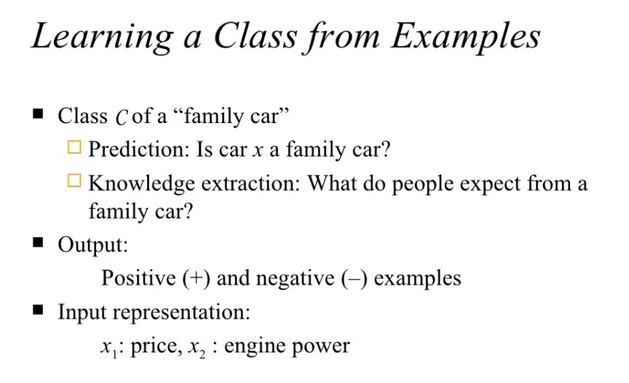

Slide 5
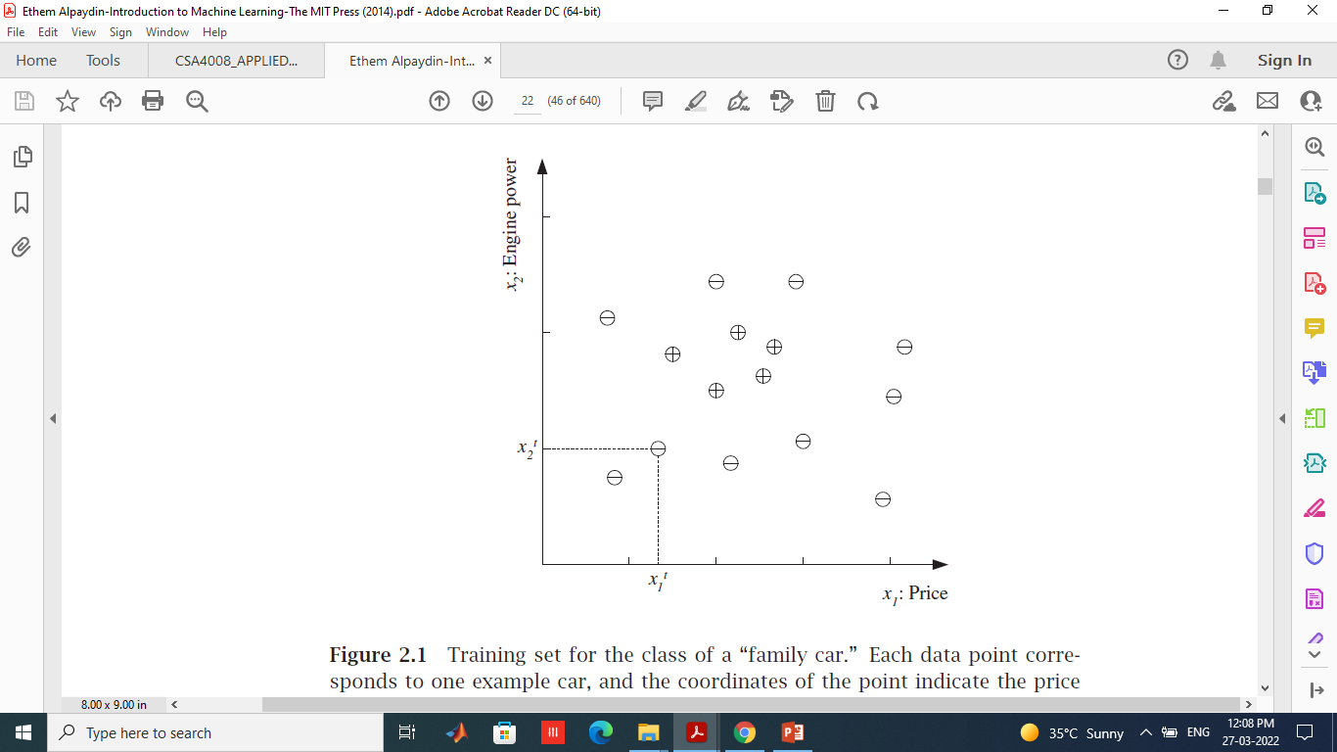
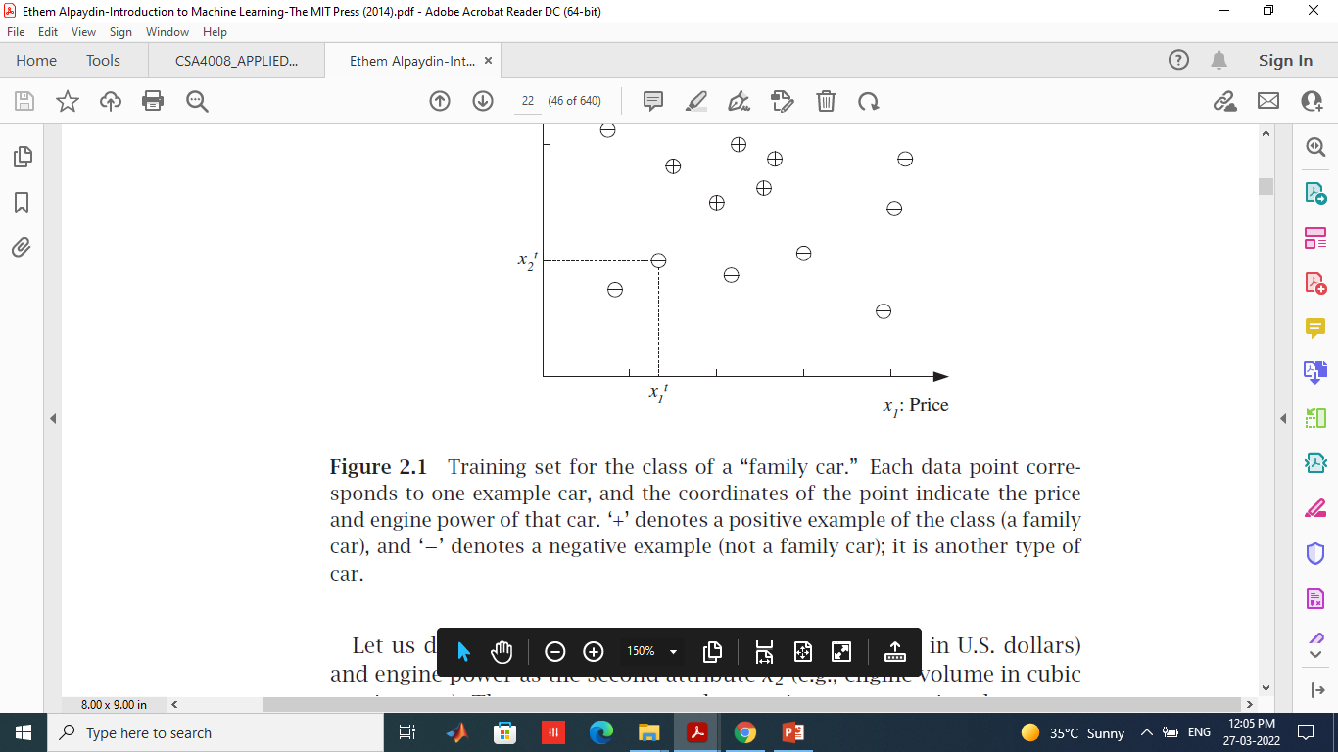

Slide 6
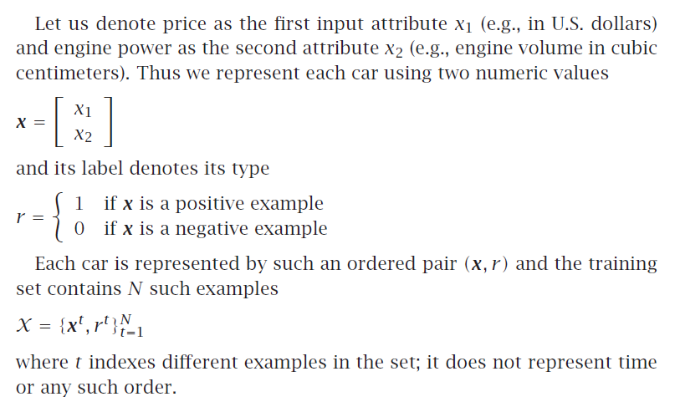

Slide 7
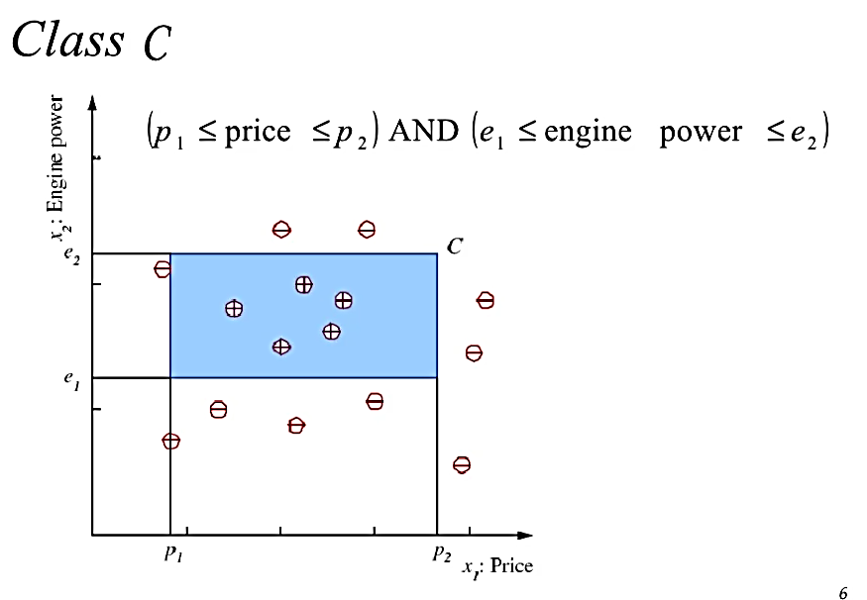

Slide 8
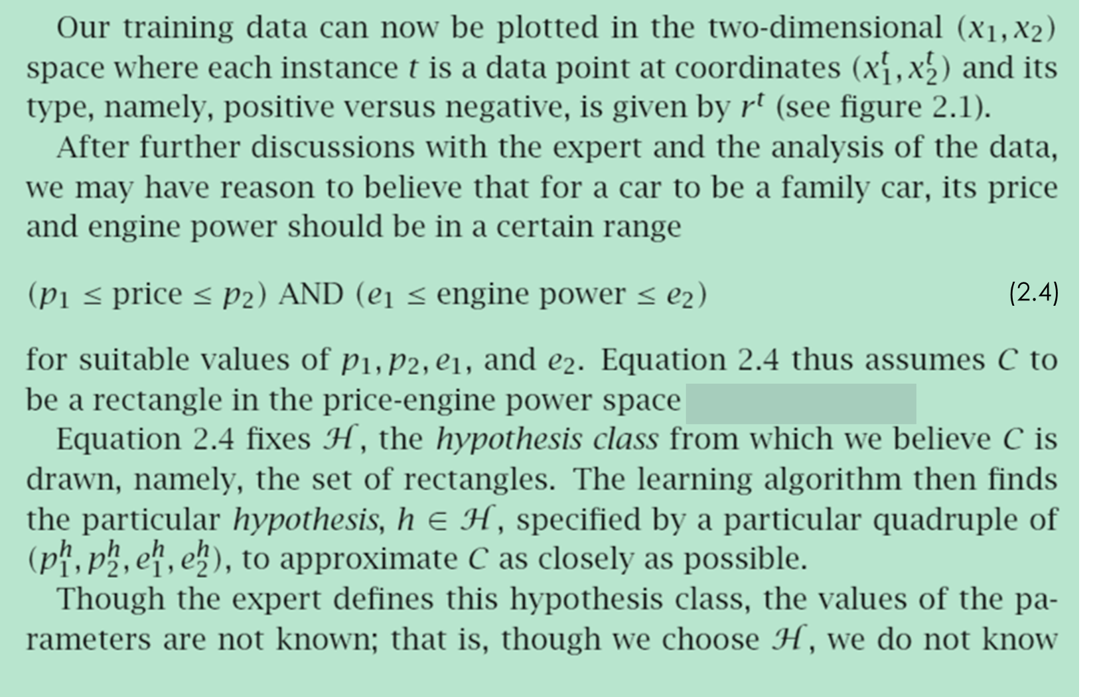

Slide 9
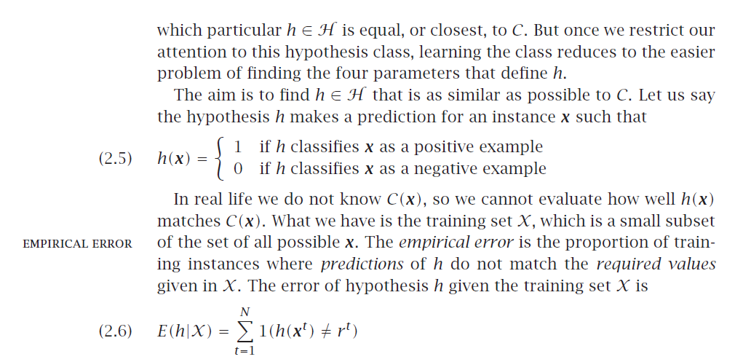

Slide 10
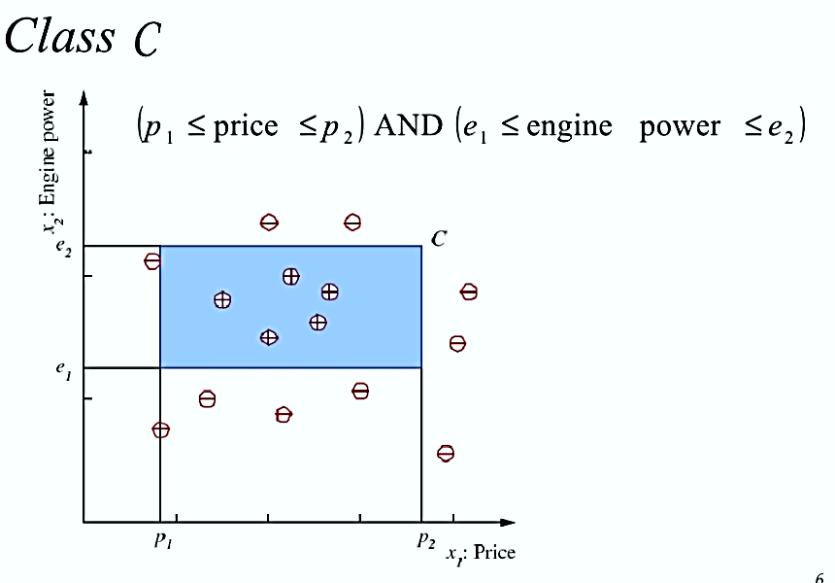
Example of a hypothesis class. The class of family car is a rectangle in the price-engine power space.

Slide 11
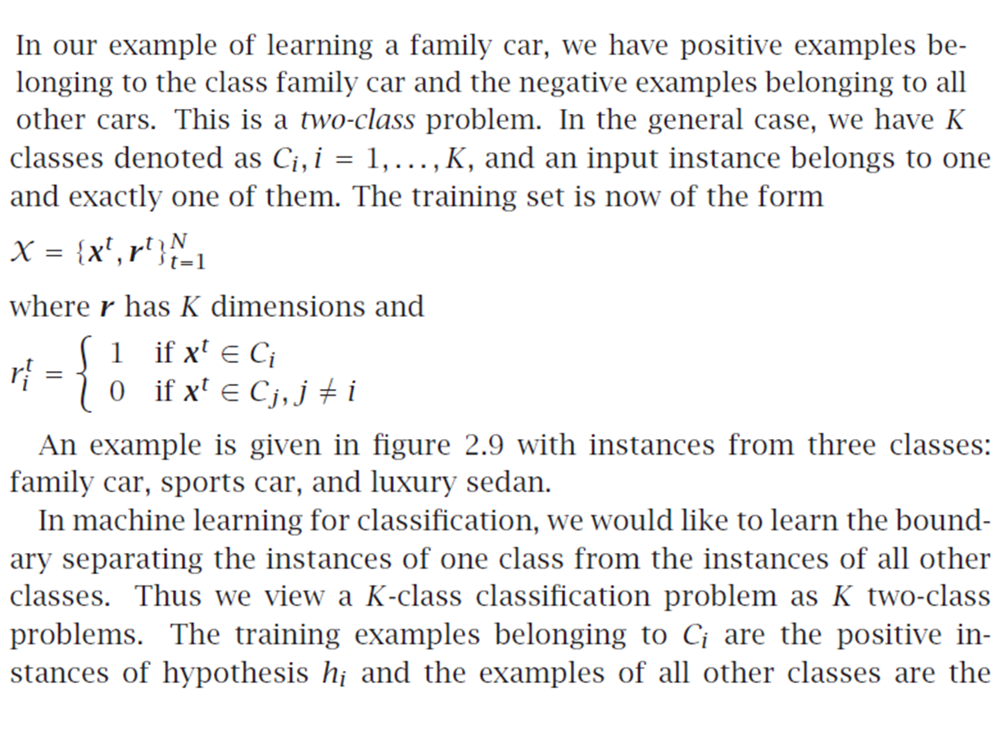
Learning Multiple Classes

Slide 12
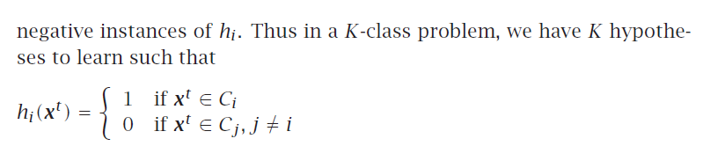

Slide 13
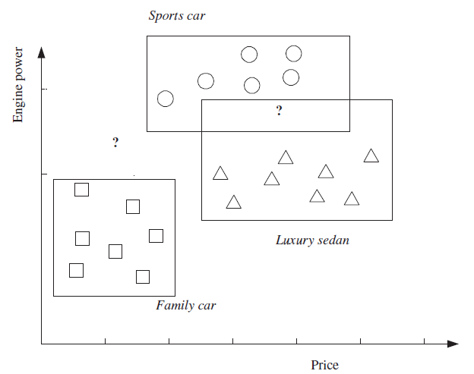
There are three classes: family car, sports car, and luxury sedan.
There are three hypotheses induced, each one covering the instances of one
class and leaving outside the instances of the other two classes. ‘?’ are reject
regions where no, or more than one, class is chosen.

Slide 14
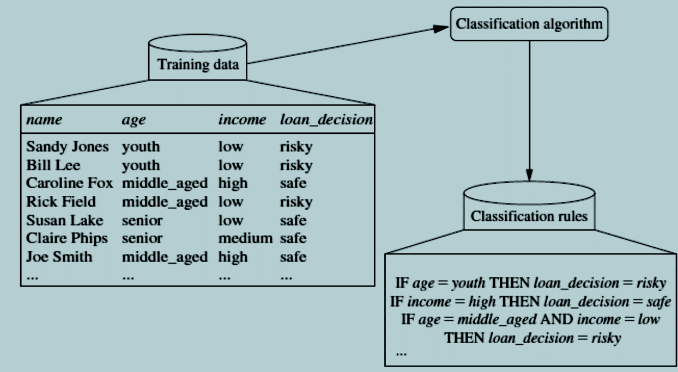
Classification
Data classification is a two-step process
1. Consisting of a learning step (where a classification model is constructed)
2. A classification step (where the model is used to predict class labels for given data).
Learning: Training data are analyzed by a classification algorithm. Here, the class label attribute is loan decision, and the learned model or classifier is represented in the form of classification rules.

Slide 15
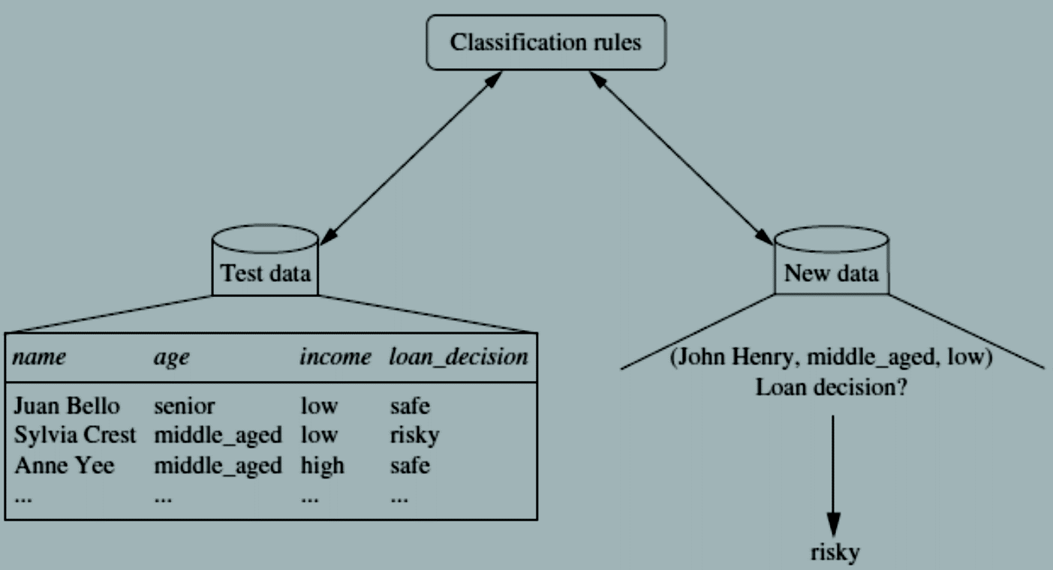
Classification:
Test data are used to estimate the accuracy of the classification rules. If the accuracy is considered acceptable, the rules can be applied to the classification of new data tuples.
Decision tree induction : learning of decision trees from class-labeled training tuples.
The accuracy of a classifier on a given test set is the percentage of test set tuples that are correctly classified by the classifier.
The associated class label of each test tuple is compared with the learned classifier’s class prediction for that tuple.

Slide 16
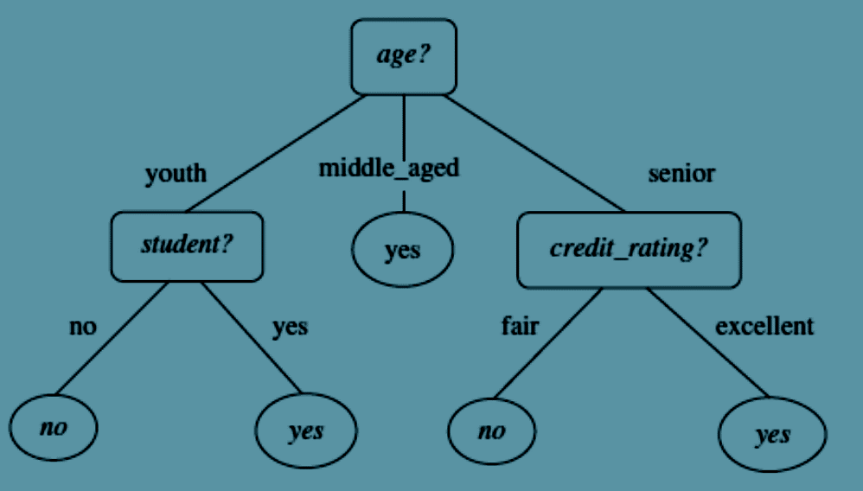
Decision Tree
Decision tree : flowchart-like tree structure, where each internal node (nonleaf node) denotes a test on an attribute, each branch represents an outcome of the test, and each leaf node (or terminal node) holds a class label.
The topmost node in a tree is the root node.
A decision tree for the concept buys computer that is, it predicts whether a customer at AllElectronics is likely to purchase a computer.
Internal nodes are denoted by rectangles, and leaf nodes are denoted by ovals.
Some decision tree algorithms produce only binary trees (where each internal node branches to exactly two other nodes), whereas others can produce nonbinary trees.
Each internal (nonleaf) node represents a test on an attribute.
Each leaf node represents a class (either buys_computer = yes or buys_computer =no).

Slide 17
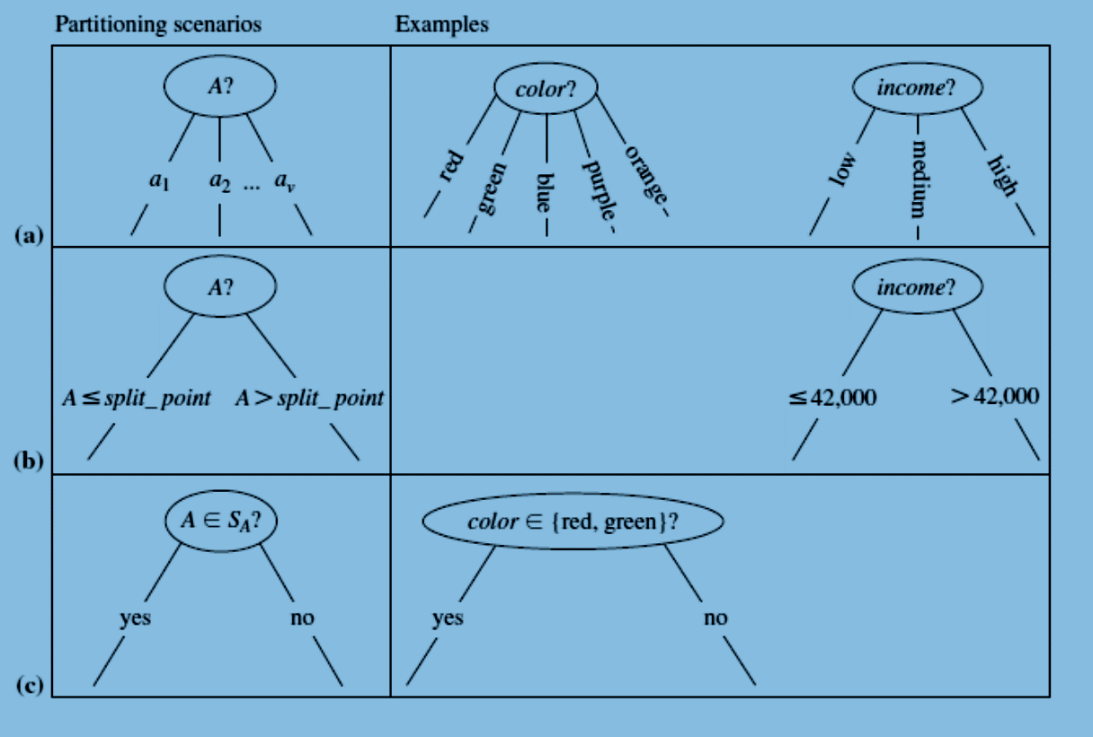
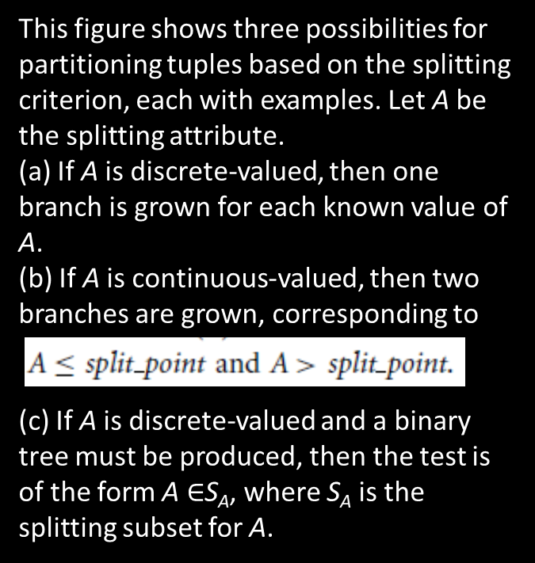
Partitioning based on the splitting criterion

Slide 18
Decision Trees
A decision tree is a hierarchical data structure implementing the divide-and-conquer strategy.
It is an efficient nonparametric method, which can be used for both classification and regression.
A decision tree is a hierarchical model for supervised learning whereby the local region is identified in a sequence of recursive splits in a smaller number of steps.
A decision tree is composed of internal decision nodes decision node and terminal leaves
Each decision node implements a test function with discrete outcomes labeling the branches.
Given an input, at each node, a test is applied and one of the branches is taken depending on the outcome. recursively until a leaf node is hit, at which point the value written in the leaf constitutes the output.
A decision tree is also a nonparametric model in the sense that we do not assume any parametric form for the class densities and the tree structure is not fixed a priori but the tree grows, branches and leaves are added, during learning depending on the complexity of the problem inherent in the data.

Slide 19
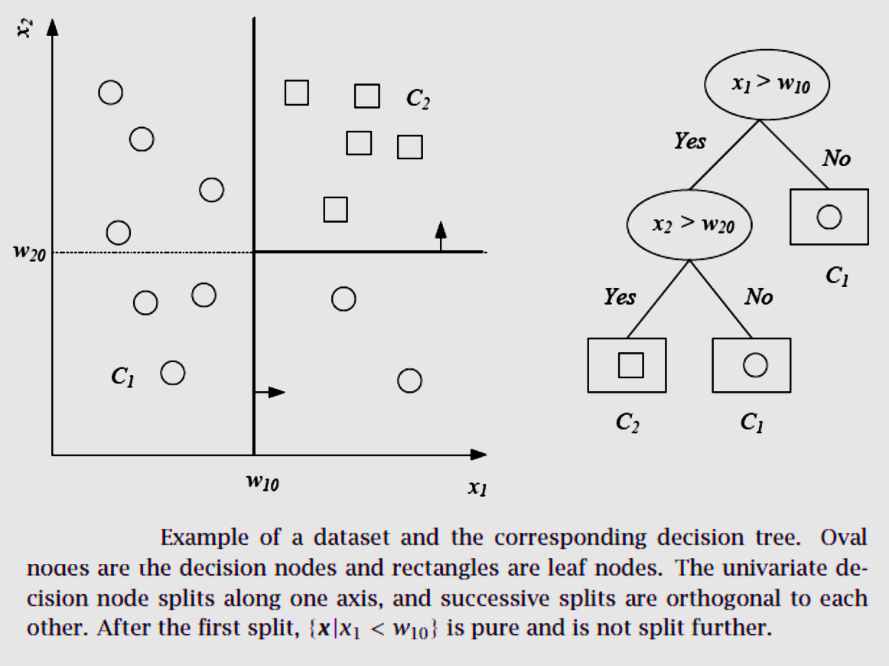
Decision Trees

Slide 20
Classification and Regression trees ????

Slide 21
Regression
Technique used for the modeling and analysis of numerical data
Exploits the relationship between two or more variables so that we can gain information about one of them through knowing values of the other
Regression can be used for prediction, estimation, hypothesis testing, and modeling causal relationships.
Linear functions provide the basis for many learning algorithms.
Can solve the problem of predicting a real-valued function from training examples.
Regression is a set of techniques for estimating relationships

Slide 22
Simple Linear Regression
Linear regression attempts to model the relationship between two variables by fitting a linear equation to observed data.
We’re going to fit a line y = b₀ + b₁x to our data. Here, x is called the independent variable or predictor variable, and y is called the dependent variable or response variable.
Before we talk about how to do the fit, let’s take a closer look at the important quantities from the fit:
• b₁ is the slope of the line: this is one of the most important quantities in any linear
regression analysis.
A value very close to 0 indicates little to no relationship; large positive or negative values indicate large positive or negative relationships, respectively.
• b₀ is the intercept of the line.
In order to actually fit a line, we’ll start with a way to quantify how good a line is. We’ll then use this to fit the “best” line we can.

Slide 23
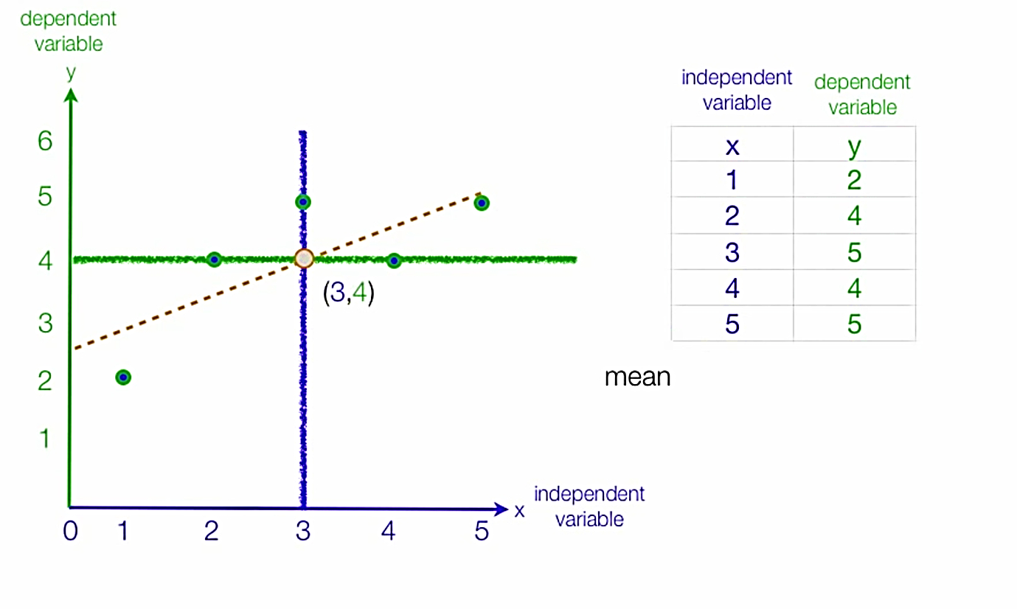
Linear Regression

Slide 24
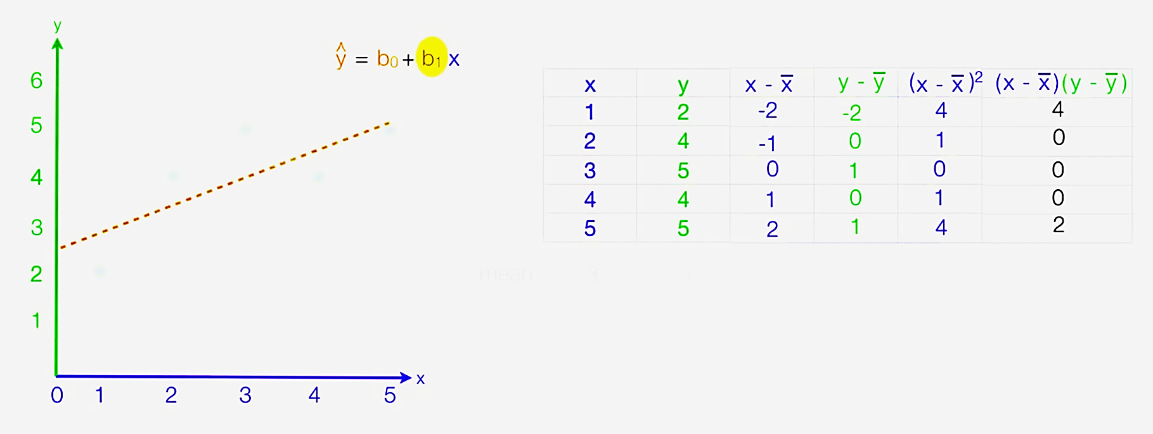

Slide 25
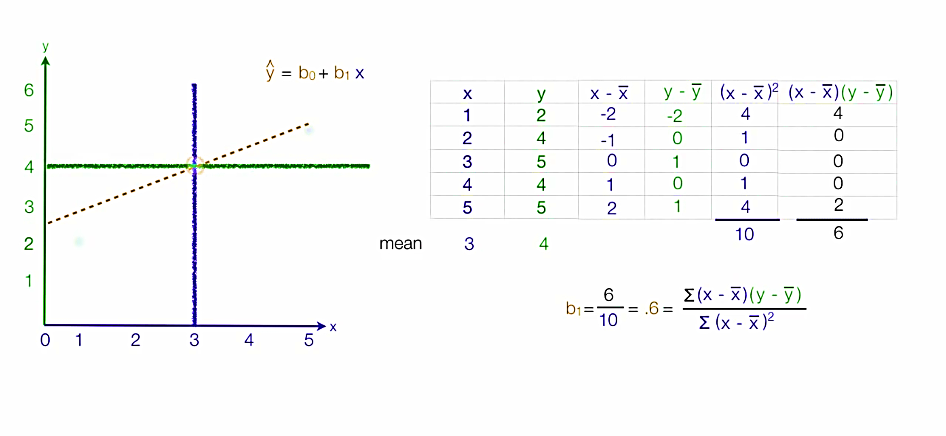

Slide 26
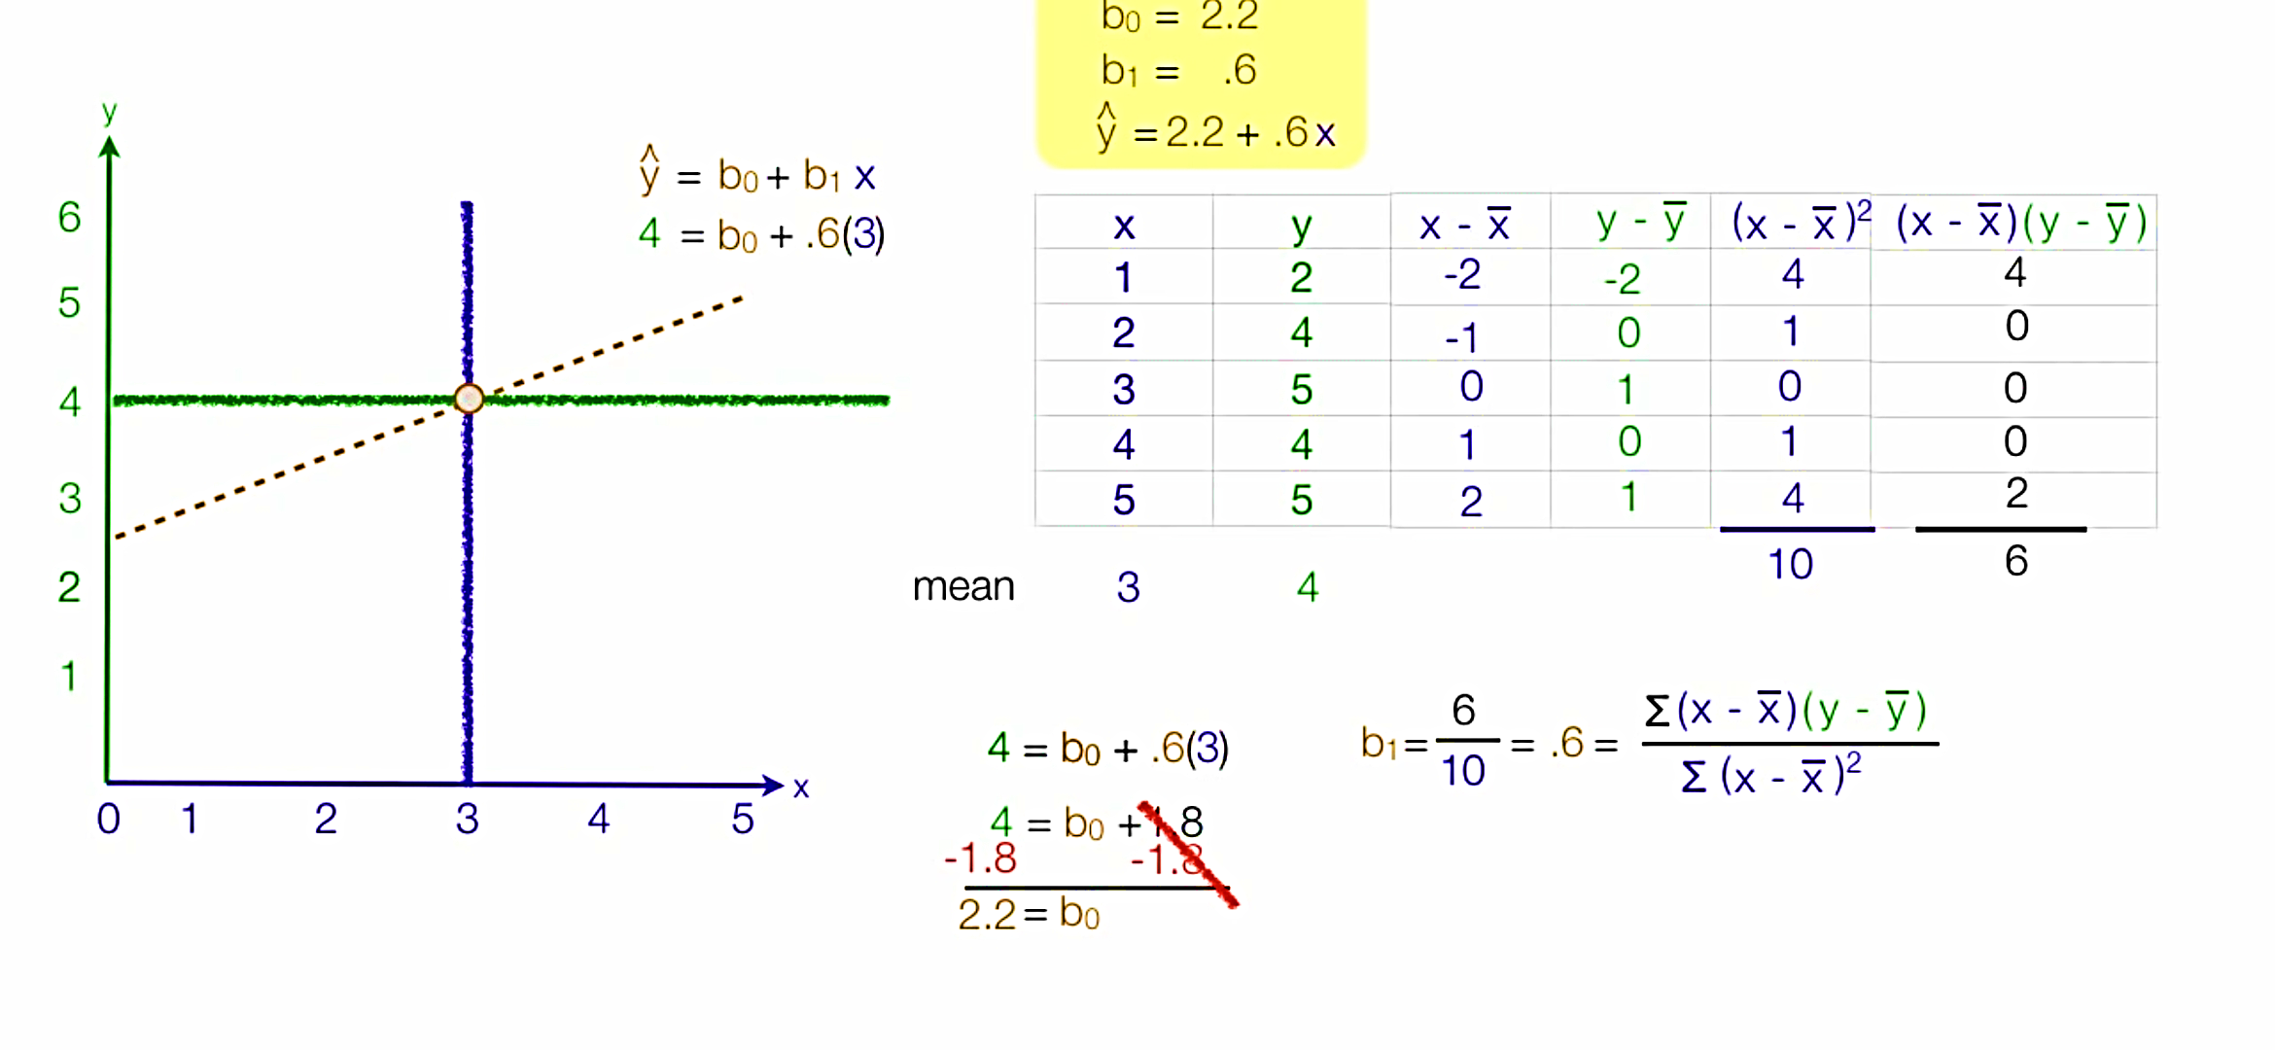

Slide 27
Goodness of fit – R²
WHAT IS R-SQUARED?
R-squared is a statistical measure of how close the data are to the fitted regression line.
It is also known as the coefficient of determination, or the coefficient of multiple determination for multiple regression.
The definition of R-squared is fairly straight-forward; it is the percentage of the response variable variation that is explained by a linear model.
R-squared = Explained variation / Total variation

Slide 28
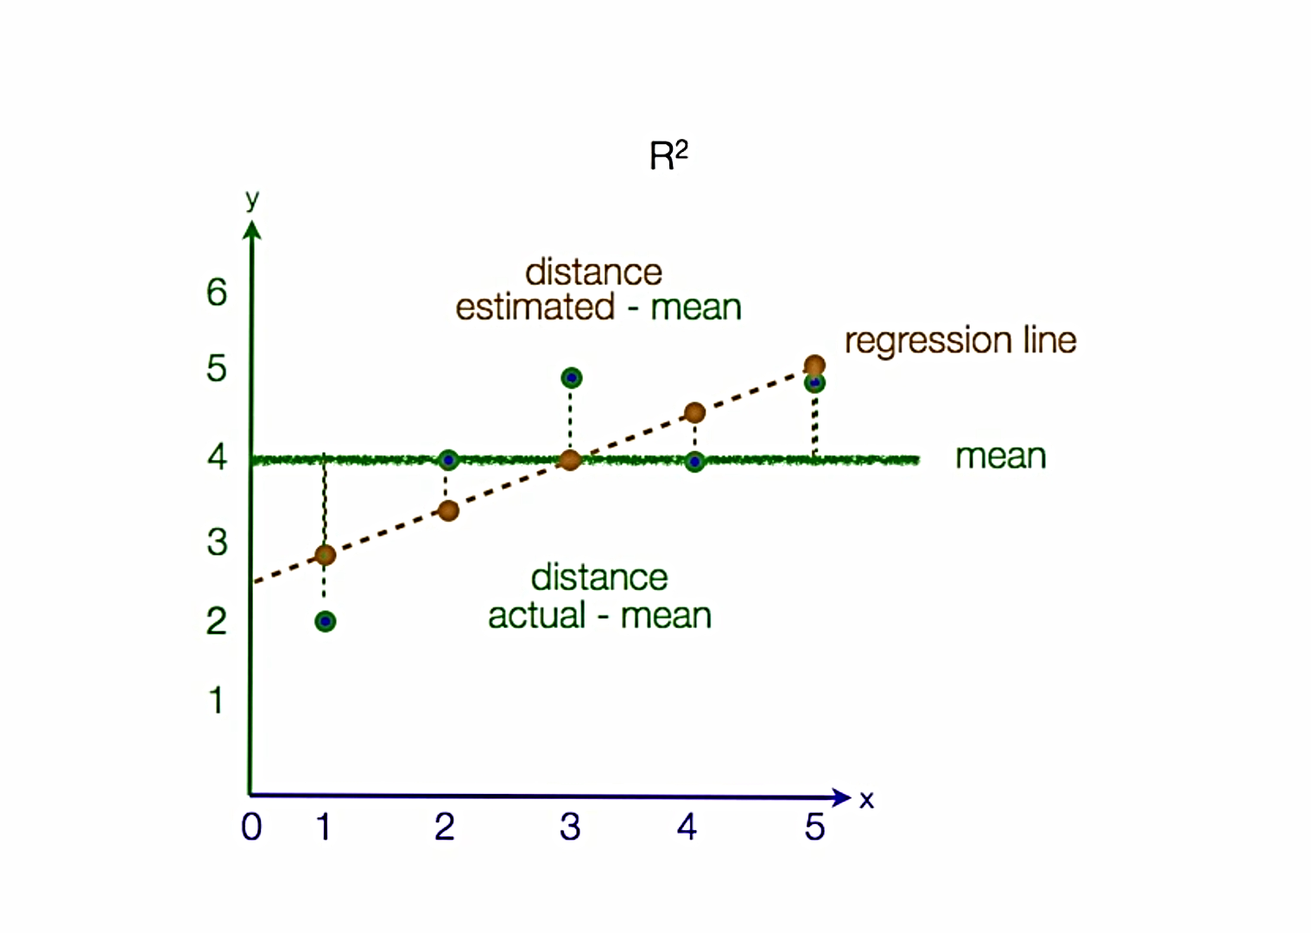
Goodness of fit – R²

Slide 29
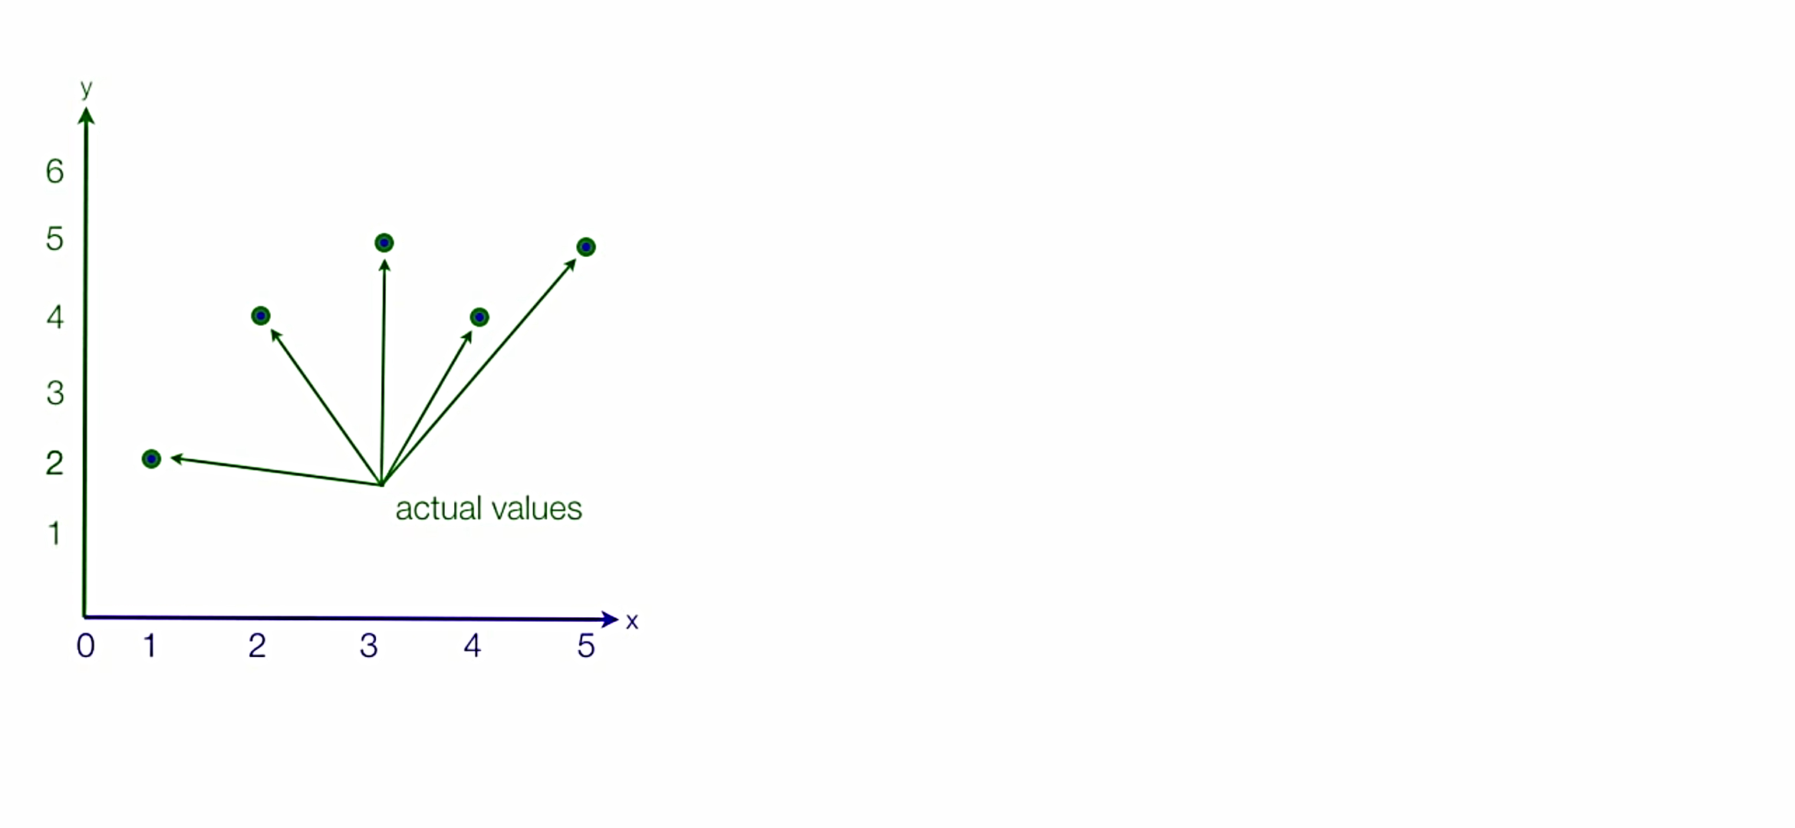
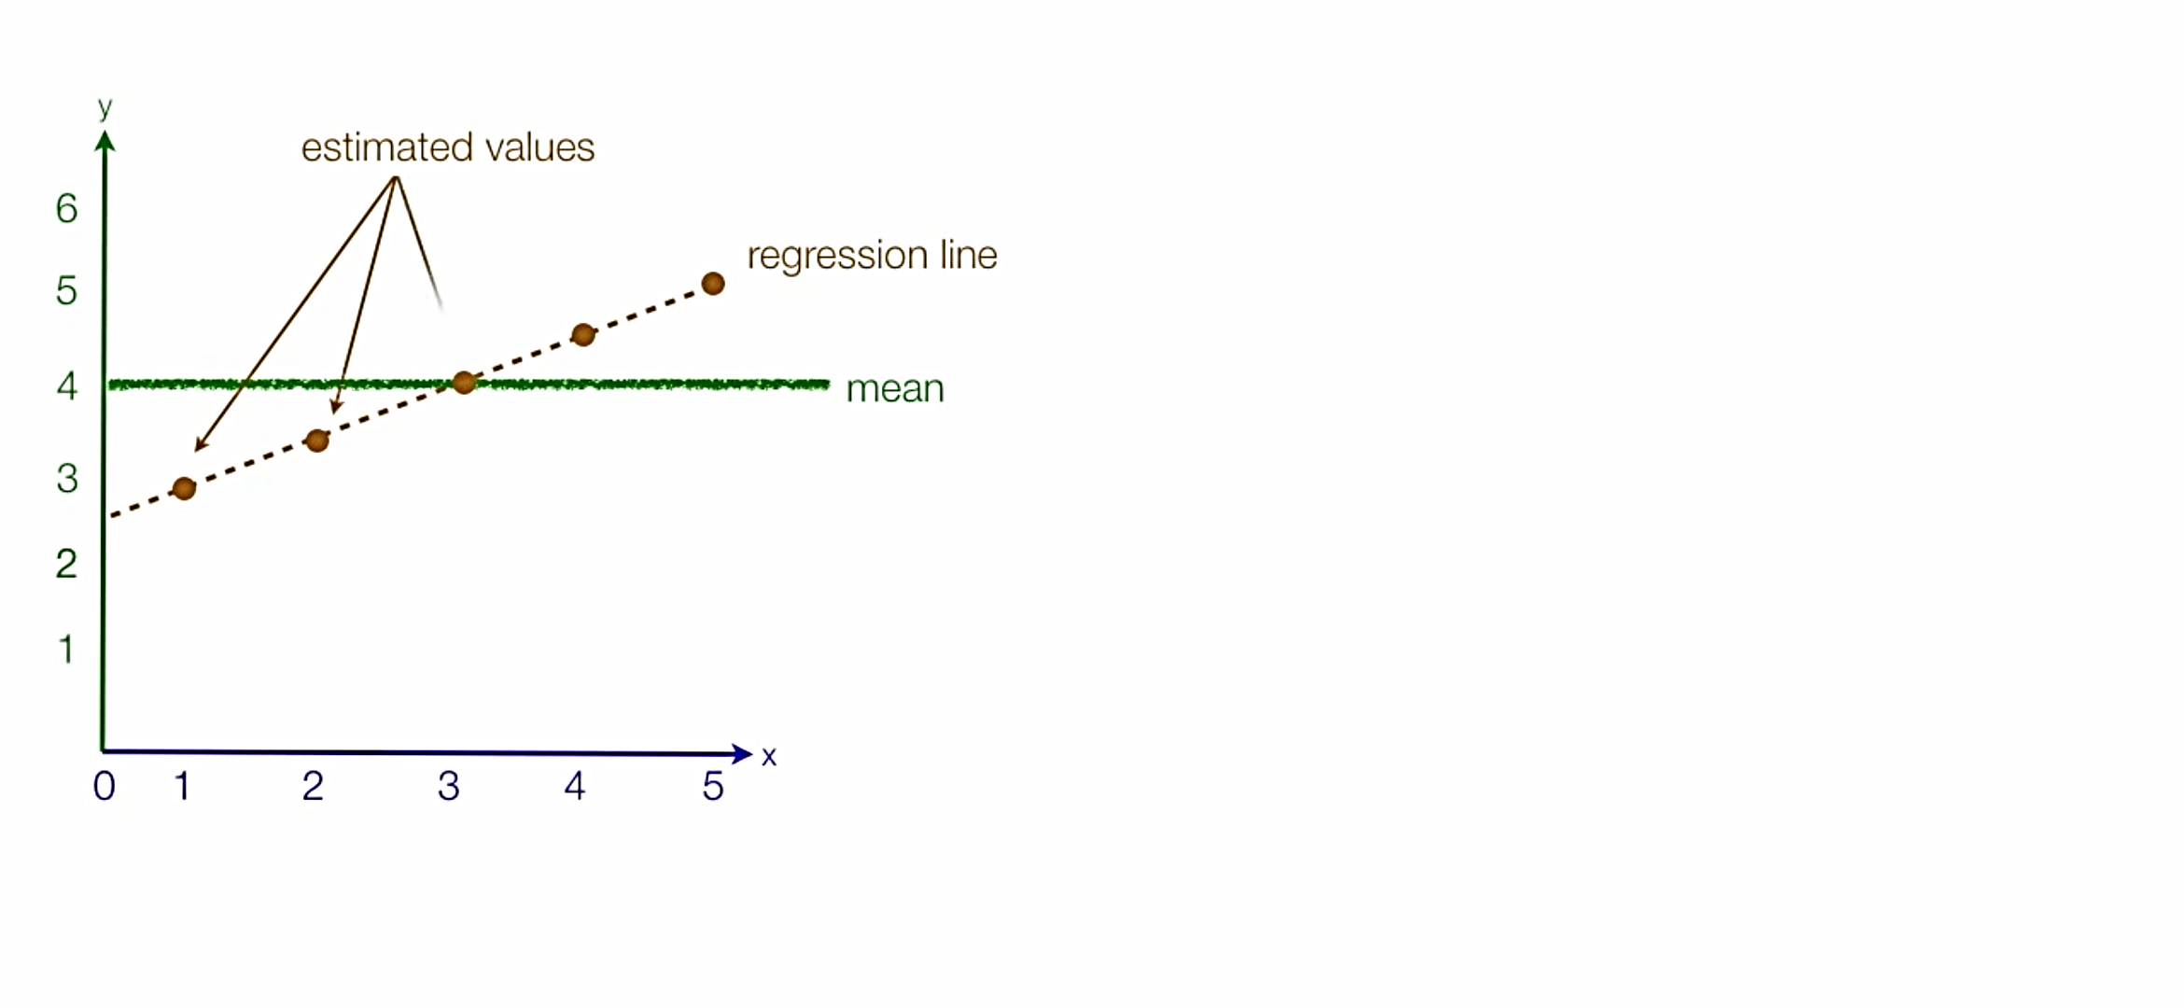

Slide 30
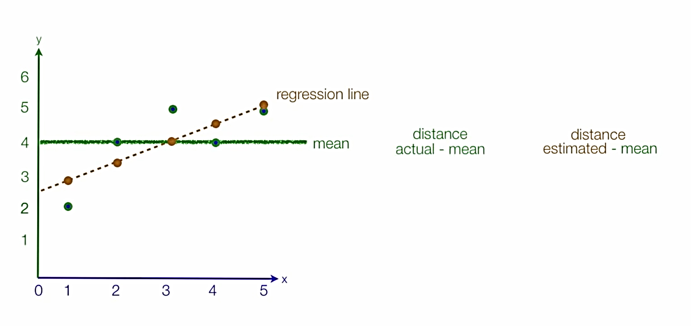

Slide 31
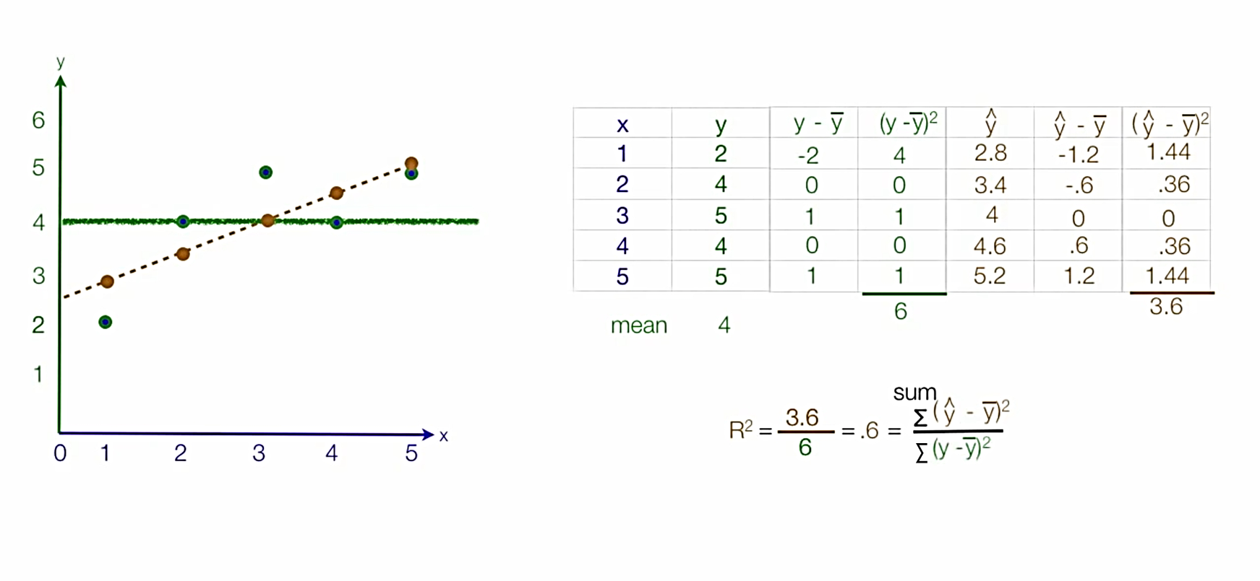

Slide 32
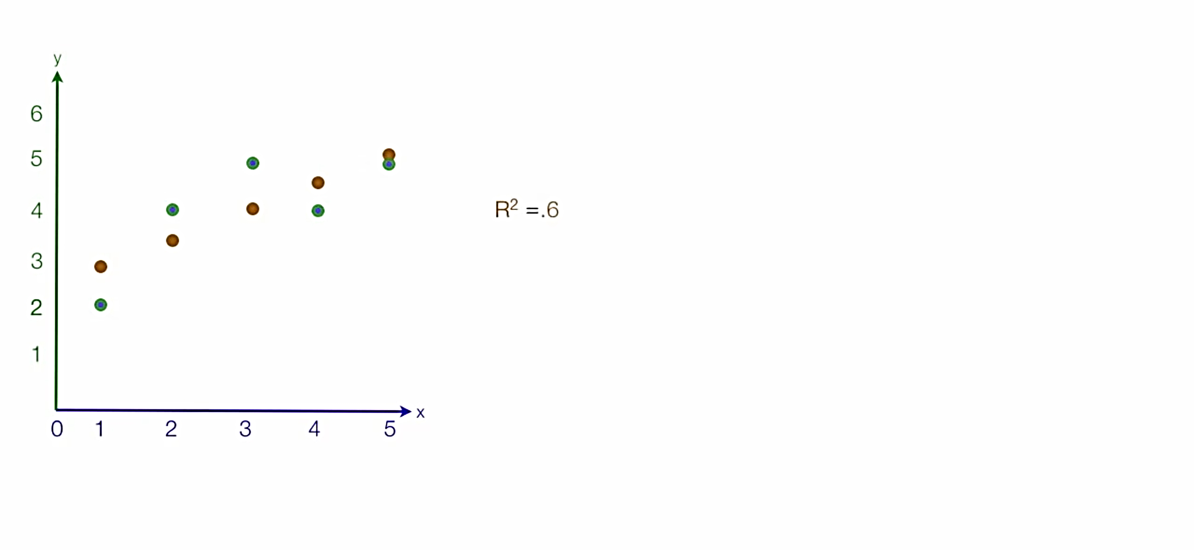
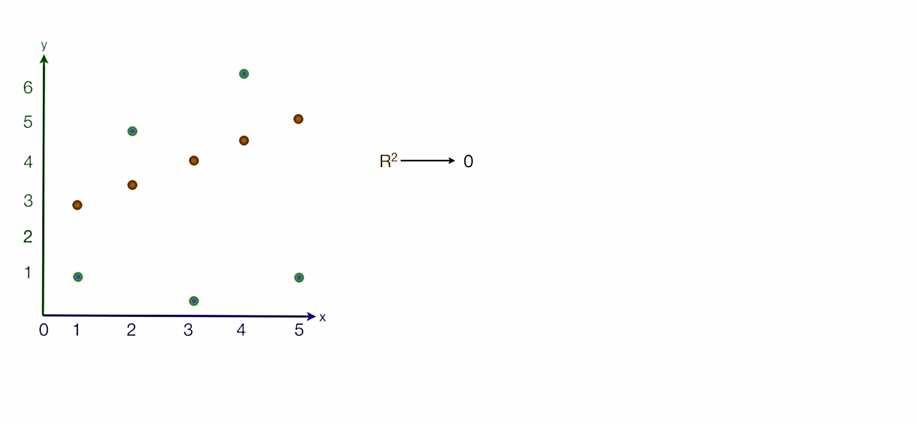
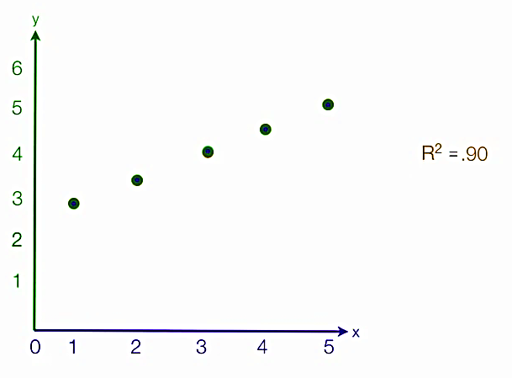
Interpretation of values of R²
R²=1
Regression line is a Perfect fit on actual values
R²=0
There is larger distance between Actual and predicted values.

Slide 33
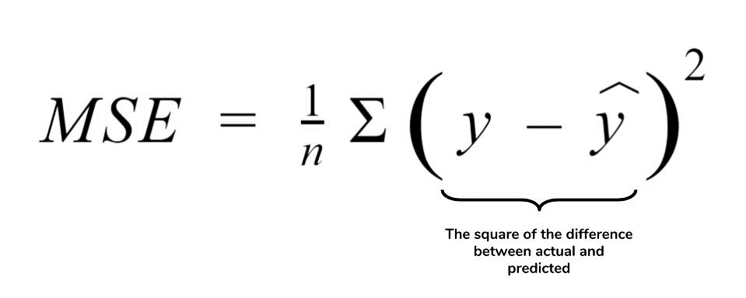
Mean Squared Error

Slide 34
Mean Squared Error Definition
The mean squared error (MSE) tells you how close a regression line is to a set of points.
It does this by taking the distances from the points to the regression line (these distances are the “errors”) and squaring them.
The squaring is necessary to remove any negative signs.
It also gives more weight to larger differences.
It’s called the mean squared error as you’re finding the average of a set of errors.
The lower the MSE, the better the forecast.

Slide 35
Mean Squared Error
General steps to calculate the MSE from a set of X and Y values:
Find the regression line.
Insert your X values into the linear regression equation to find the new Y values (Y’).
Subtract the new Y value from the original to get the error.
Square the errors.
Add up the errors (the Σ in the formula is summation notation).
Find the mean.

Slide 36
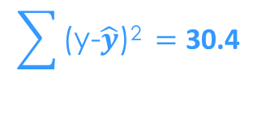
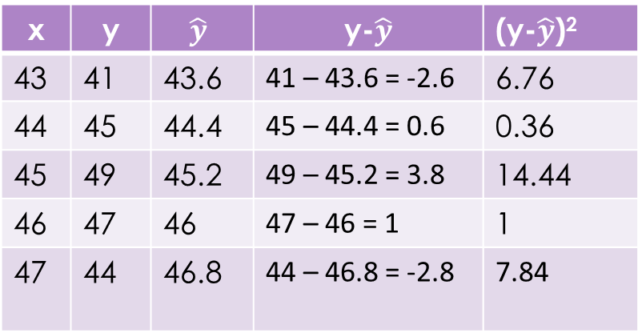
Mean Squared Error
Example Problem:
Find the MSE for the following set of values: (43,41), (44,45), (45,49), (46,47), (47,44).
Step 1: Find the regression line.
Regression line ý = 9.2 + 0.8x.
Step 2: Find the new Y’ values:
9.2 + 0.8(43) = 43.6
9.2 + 0.8(44) = 44.4
9.2 + 0.8(45) = 45.2
9.2 + 0.8(46) = 46
9.2 + 0.8(47) = 46.8
x | y | $$\hat{y}$$ | y-$\hat{y}$ | (y-$\hat{y}$)²
43 | 41 | 43.6 | 41 – 43.6 = -2.6 | 6.76
44 | 45 | 44.4 | 45 – 44.4 = 0.6 | 0.36
45 | 49 | 45.2 | 49 – 45.2 = 3.8 | 14.44
46 | 47 | 46 | 47 – 46 = 1 | 1
47 | 44 | 46.8 | 44 – 46.8 = -2.8 | 7.84
$$\sum{\text{(}\text{y}\text{−}\hat{y}\text{)}\text{2 }}=\text{30.4}$$

Slide 37
Step 3: Find the error (Y – Y’):
41 – 43.6 = -2.6
45 – 44.4 = 0.6
49 – 45.2 = 3.8
47 – 46 = 1
44 – 46.8 = -2.8
Step 4: Square the Errors:
-2.6² = 6.76
0.6² = 0.36
3.8² = 14.44
1² = 1
-2.8² = 7.84
Step 5: Add all of the squared errors up: 6.76 + 0.36 + 14.44 + 1 + 7.84 = 30.4
Step 6: Find the mean squared error: 30.4 / 5 = 6.08.

Slide 38
What does the Mean Squared Error Tell You?
The smaller the mean squared error, the closer you are to finding the line of best fit.
Depending on your data, it may be impossible to get a very small value for the mean squared error.
For example, the above data is scattered wildly around the regression line, so 6.08 is as good as it gets (and is in fact, the line of best fit).
The smallest MSE would be the line of best fit.

Slide 39
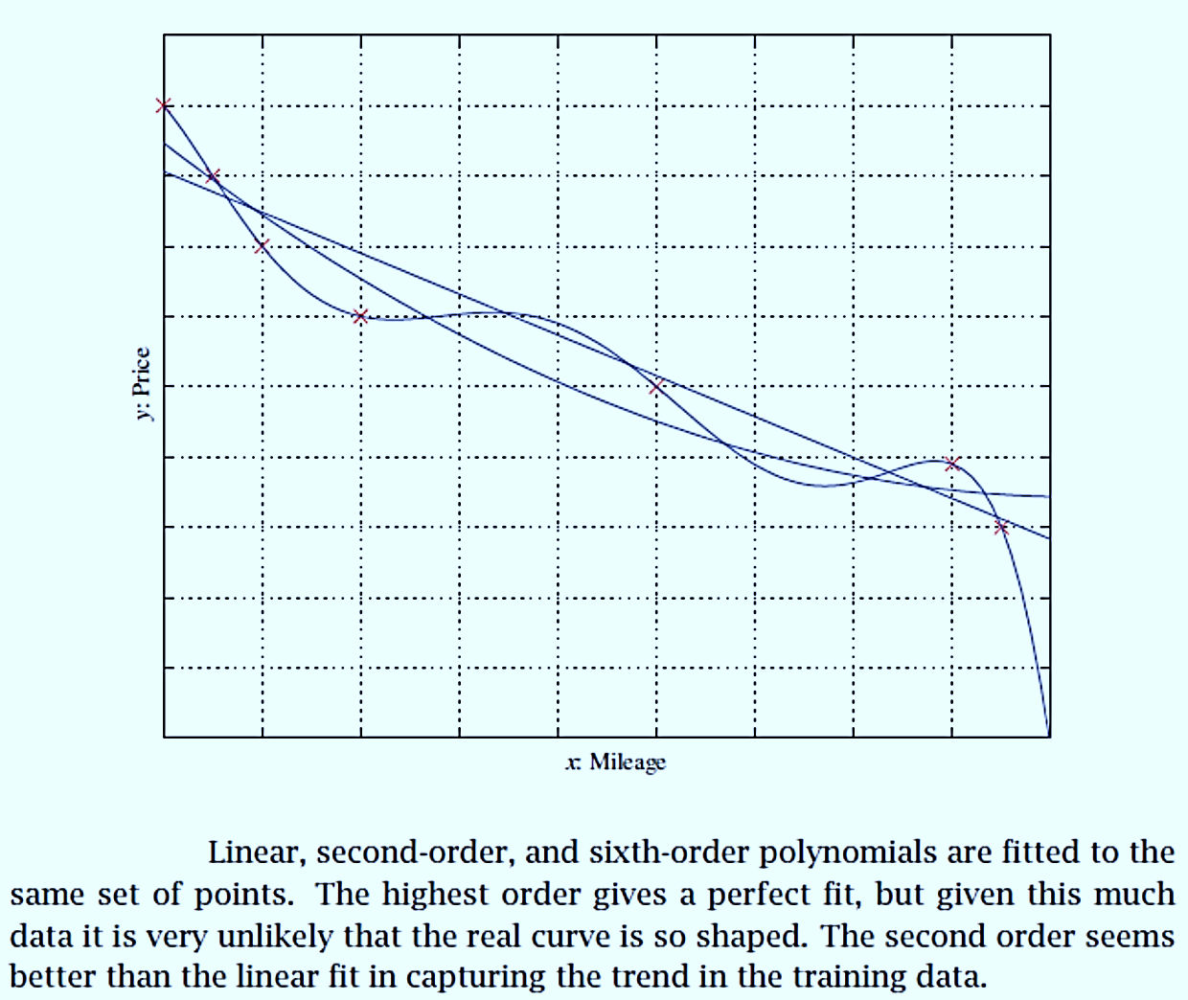

Slide 40
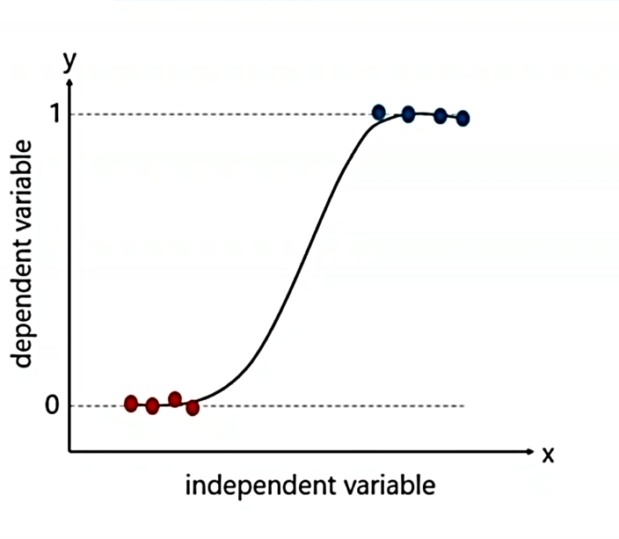
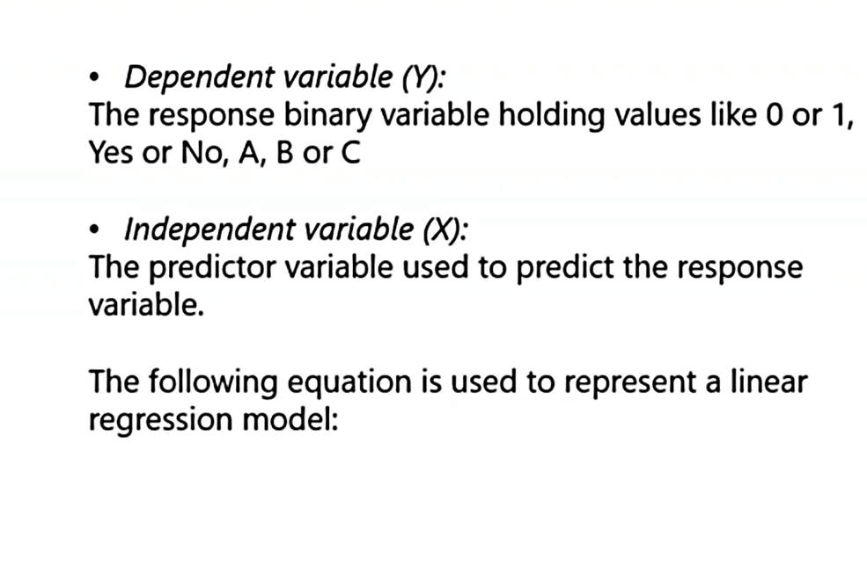
Logistic regression

Slide 41
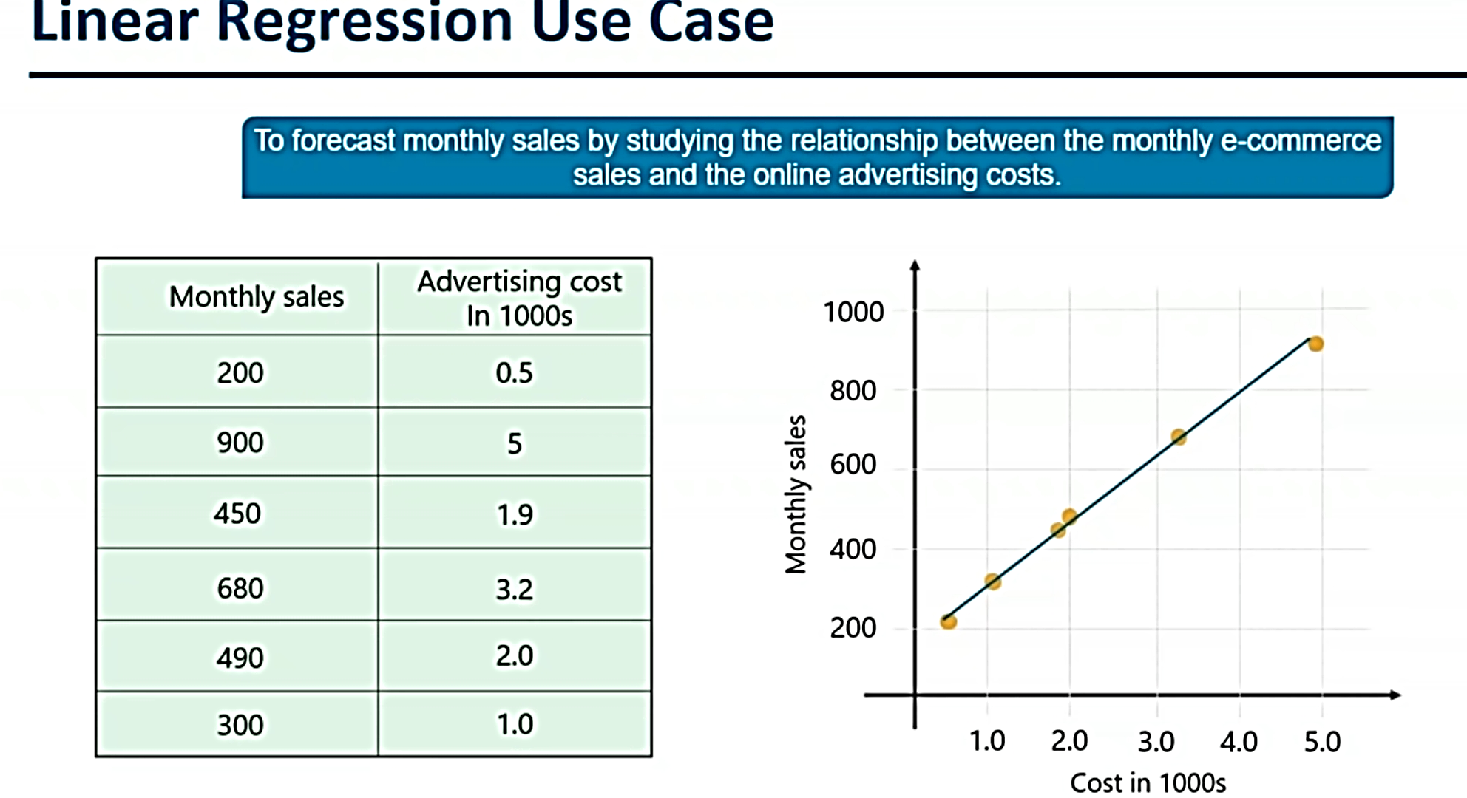

Slide 42
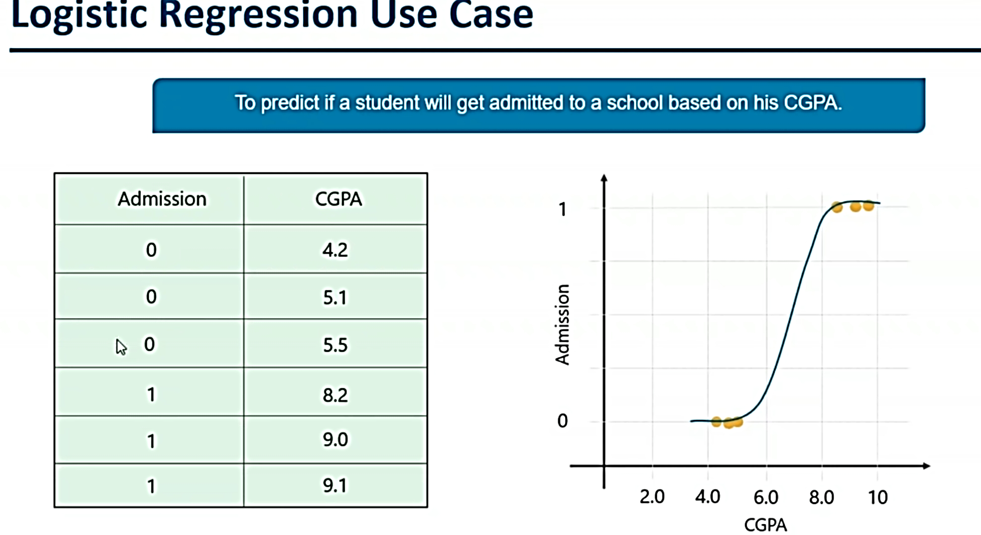

Slide 43
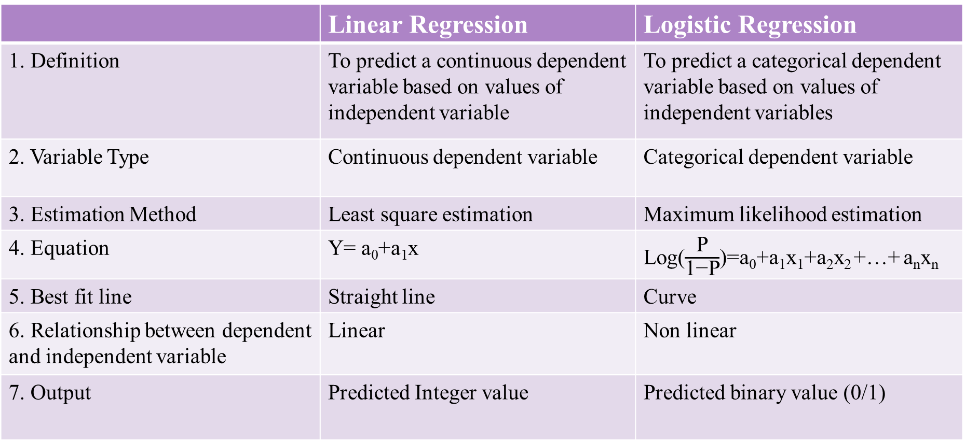
 | Linear Regression | Logistic Regression
1. Definition | To predict a continuous dependent variable based on values of independent variable | To predict a categorical dependent variable based on values of independent variables
2. Variable Type | Continuous dependent variable | Categorical dependent variable
3. Estimation Method | Least square estimation | Maximum likelihood estimation
4. Equation | Y= a₀+a₁x | Log($\frac{\text{P}}{\text{1−}\text{P}}$)=a₀+a₁x₁+a₂x₂ +…+ a_{n}x_{n}
5. Best fit line | Straight line | Curve
6. Relationship between dependent and independent variable | Linear | Non linear
7. Output | Predicted Integer value | Predicted binary value (0/1)

Slide 44
Classification
Data classification is a two-step process
1. Consisting of a learning step (where a classification model is constructed)
2. A classification step (where the model is used to predict class labels for given data).
Learning: Training data are analyzed by a classification algorithm. Here, the class label attribute is loan decision, and the learned model or classifier is represented in the form of classification rules.

Slide 45
Classification:
Test data are used to estimate the accuracy of the classification rules. If the accuracy is considered acceptable, the rules can be applied to the classification of new data tuples.
Decision tree induction : learning of decision trees from class-labeled training tuples.
The accuracy of a classifier on a given test set is the percentage of test set tuples that are correctly classified by the classifier.
The associated class label of each test tuple is compared with the learned classifier’s class prediction for that tuple.

Slide 46
Decision Tree
Decision tree : flowchart-like tree structure, where each internal node (nonleaf node) denotes a test on an attribute, each branch represents an outcome of the test, and each leaf node (or terminal node) holds a class label.
The topmost node in a tree is the root node.
A decision tree for the concept buys computer that is, it predicts whether a customer at AllElectronics is likely to purchase a computer.
Internal nodes are denoted by rectangles, and leaf nodes are denoted by ovals.
Some decision tree algorithms produce only binary trees (where each internal node branches to exactly two other nodes), whereas others can produce nonbinary trees.
Each internal (nonleaf) node represents a test on an attribute.
Each leaf node represents a class (either buys_computer = yes or buys_computer =no).

Slide 47
Partitioning based on the splitting criterion

Slide 48
Support Vector Machines (SVM)
SVM is a non-probabilistic linear classification approach that chooses an optimal separating hyperplane such that it maximizes the distance between data points of different classes.
To construct the best solution for separating hyperplane, training data points are used which are considered as vectors or support vectors.
These support vectors help in determining the width of the hyperplane. SVM can be extended for the cases where data is not separated by a hard margin.
Hence, a trade-off parameter is used which allows margin to be flexible and separates non linearly separable data. In addition to that, SVM can be used to classify nonlinear data using kernel trick.
This is the reason behind extensive use to SVM as it achieves to an optimal solution for both linear and nonlinear data.

Slide 49
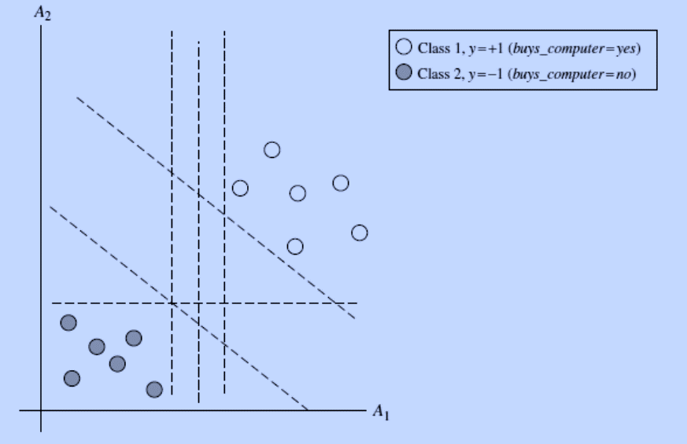
The 2-D training data are linearly separable.
There are an infinite number of possible
separating hyperplanes or “decision boundaries,” some of which are shown here as dashed lines.
Which one is best?
Generalizing to n dimensions, we want to find the best hyperplane.
We will use “hyperplane” to refer to
the decision boundary that we are seeking, regardless of the number of input attributes.
How can we find the best hyperplane?
An SVM approaches this problem by searching for the maximum marginal hyperplane.

Slide 50
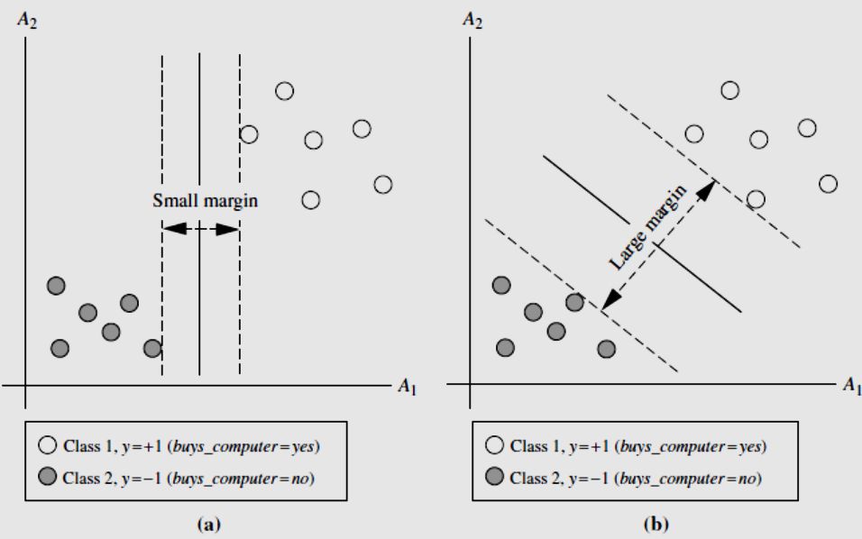

Slide 51
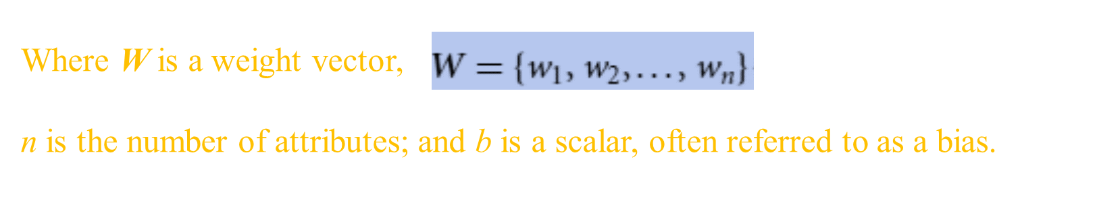
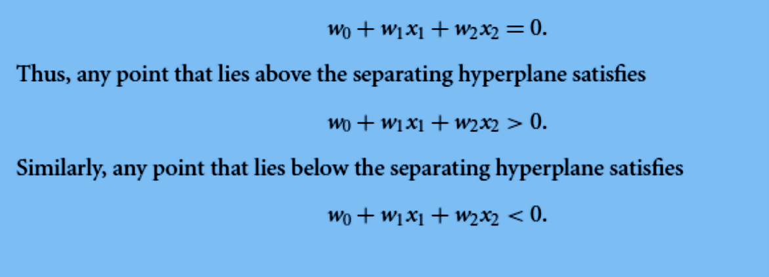
Training tuples are 2-D, e.g., X = (x₁, x₂), where x₁ and x₂ are the values of attributes A₁ and A₂, respectively, for X. If we think of b as an additional weight, w₀, we can rewrite hyperplane as

Slide 52
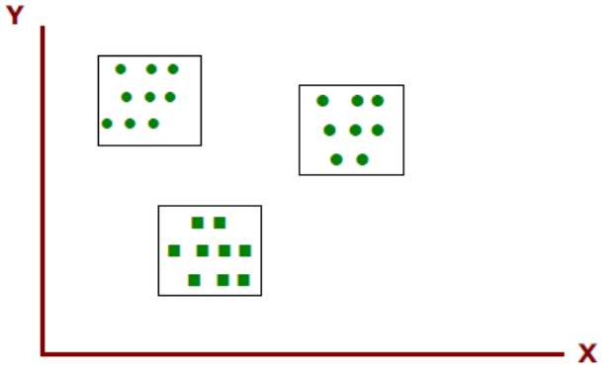
Clustering
Clustering is a way to form natural groupings or clusters of patterns. Clustering is often called an unsupervised learning.
Example : Three natural groups of data points, i.e., 3 natural clusters.
Example : Three natural groups of data points, i.e., 3 natural clusters.

Slide 53
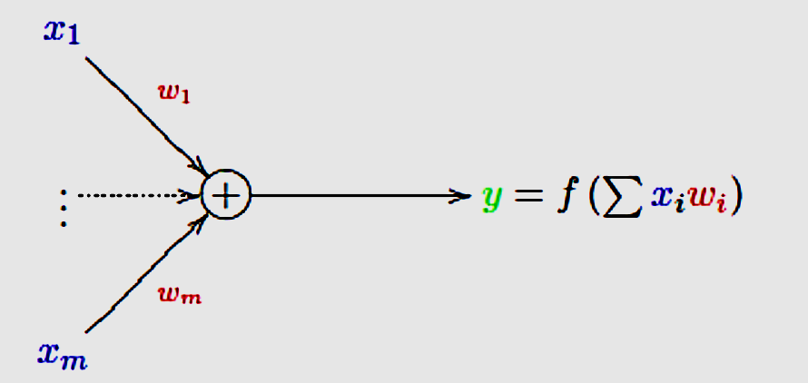
A Model of A Single Neuron
A Model of a Single Neuron (Unit)
McCulloch and Pitts (1943) proposed the ‘integrate and fire’ model:
Denote the m input values by x₁, x₂, . . . , x_{m}.
• Each of the m inputs (synapses) has a weight w₁, w₂, . . . , w_{m}.
• The input values are multiplied by their weights and summed

Slide 54
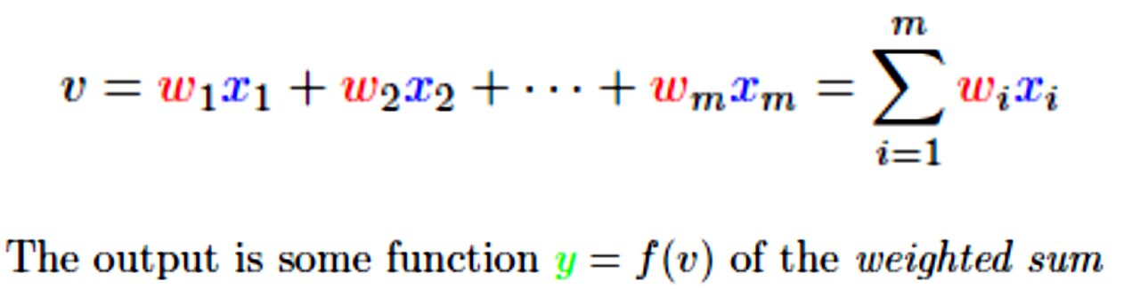

Slide 55
Artificial Neuron - Basic Elements

Slide 56
Role of the Activation functions in Neural Networks
The reason for using activation functions in Neural Networks are as follows:
1. The idea behind the activation function is to introduce nonlinearity into the neuron so that it can learn more complex functions.
2. Without the Activation function, the neural network behaves as a linear classifier, learning the function which is a linear combination of its input data.
4. The activation function is responsible for deciding whether a neuron should be activated i.e, fired or not.
5. To make the decision, firstly it calculates the weighted sum and further adds bias with it.

Slide 57
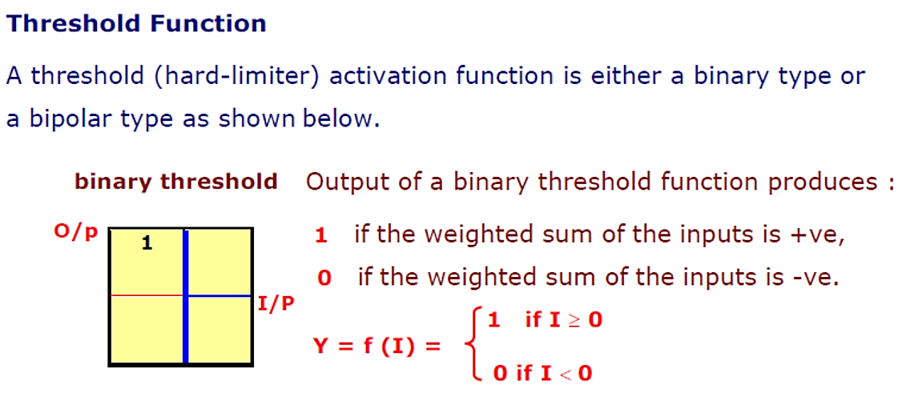
Neuron with hard limiter activation function is called McCulloch-Pitts model.

Slide 60
Sigmoidal Function (S-shape function)
The nonlinear curved S-shape function is called the sigmoid function.
This is most common type of activation used to construct the neural networks.
It is mathematically well behaved, differentiable and strictly increasing function.
The sigmoidal function is achieved using exponential equation.
By varying α different shapes of the function can be obtained which adjusts the abruptness of the function as it changes between the two asymptotic values.

Slide 61
Example : 1
The neuron shown consists of four inputs with the weights.

Slide 62
The output I of the network, prior to the activation function stage, is

Slide 63
Example 2
The node has three inputs x = (x1, x2, x3) that receive only binary signals (either 0 or 1). How many different input patterns this node can receive?
Can you give a formula that
computes the number of binary input patterns for a given number of inputs?
Single unit with three inputs

Slide 64
Example 3
Logical operators (i.e. NOT, AND, OR, XOR, etc) are the building blocks of any computational device. Logical functions return only two possible values, true or false, based on the truth or false values of their arguments. For example, operator AND returns true only when all its arguments are true, otherwise (if any of the arguments is false) it returns false. If we denote truth by 1 and false by 0, then logical function AND can be represented by the following table:
This function can be implemented by a single-unit with two inputs:

Slide 65
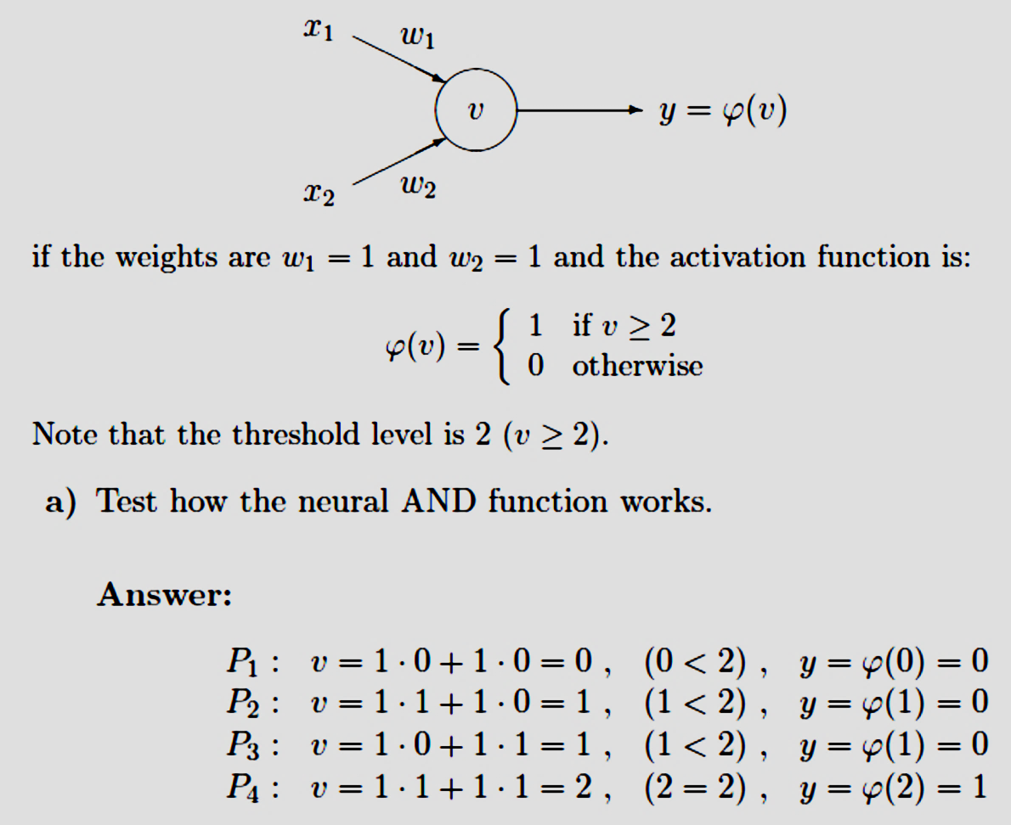

Slide 66
There are several classes of Neural Networks, classified according to their learning mechanism.
Fundamentally three different classes of Networks
Single Layer Feedforward Network
Multilayer Feedforward Network
Recurrent Networks
1. Single Layer Feedforward Network
Network comprises of two layers:
- Input Layer
- Output Layer
The input layer neurons receive the input signals and the output layer neurons receive the output signals.
The synaptic links carrying the weights connect every input neuron to the output neuron but not vice-versa. Such a network is said to be feedforward in type or acyclic in nature

Slide 67
The sum of the products of the weights and the inputs is calculated in each neuron node, and if the value is above some threshold (typically 0) the neuron fires and takes the activated value (typically 1); otherwise it takes the deactivated value (typically -1).
X_{i} : Input neurons
Y_{j} : Output neurons
W_{ij} : Weights
Networks without cycles (feedback loops) are called a feed-forward networks (or perceptron).

Slide 68
2. Multilayer Feedforward Network
The name suggests, it consists of multiple layers.
The architecture of this class of network, besides having the input and the output layers, also have one or more intermediary layers called hidden layers.
The computational units of the hidden layer are known as hidden neurons.
Hidden layer aids in performing useful intermediatory computations before directing the input layer to the output layer.
The input neurons are linked to the hidden layer neurons and the weights on these links are referred to as input-hidden layer weights.
Again the hidden layer neurons are lined to the output layer neurons and the corresponding weights are referred to as hidden-output layer weights.
A multilayer feedforward network with l input neurons in the input layer, m neurons in the hidden layer and n neurons in the output layer is with a configuration l-m-n.

Slide 69
A multi-layer feed-forward network with ℓ input neurons, m1 neurons in the first hidden layers, m2 neurons in the second hidden layers, and n
output neurons in the output layers is written as (ℓ - m1 - m2 – n ).

Slide 70
3. Recurrent networks
The Recurrent Networks differ from feed-forward architecture.
A Recurrent network has at least one feed back loop.
There could be neurons with self-feedback links; that is the output of a neuron is feedback into itself as input.

Slide 71
Characteristics of Neural Networks
The NNs exhibits mapping capabilities, that is they can map input patterns to their associated output patterns
The NNs learn by examples. Thus NN architectures can be trained with known examples of a problem before they are tested for their ‘inference’ capability on unknown instances of the problem. They can, therefore, identify new objects previously untrained.
The NN possess the capability to generalize. Thus they can predict new outcomes from past trends.
The NN are robust systems and are fault tolerant. They can therefor, recall full patterns from incomplete, partial or noisy patterns.
The NNs can process information in parallel, at high speed, and in a distributed manner

Slide 72
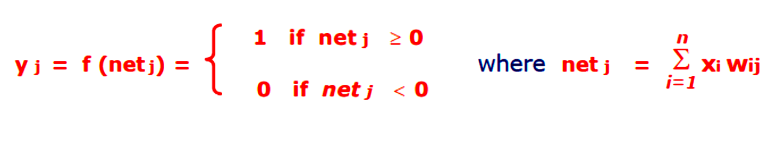
Single layer neural network system: Perceptron
One of the earliest network model proposed by Rosenblatt in 1962.
The perceptron algorithm was designed to classify visual inputs, categorizing subjects into one of two types and separating groups with a line.
Capable to classify patterns.
A single perceptron can only be used to implement linearly separable functions.
It takes both real and Boolean inputs and associates a set of weights to them, along with a bias
Definition : An arrangement of one input layer of neurons feed forward to one output layer of neurons is known as Single Layer Perceptron.

Slide 73
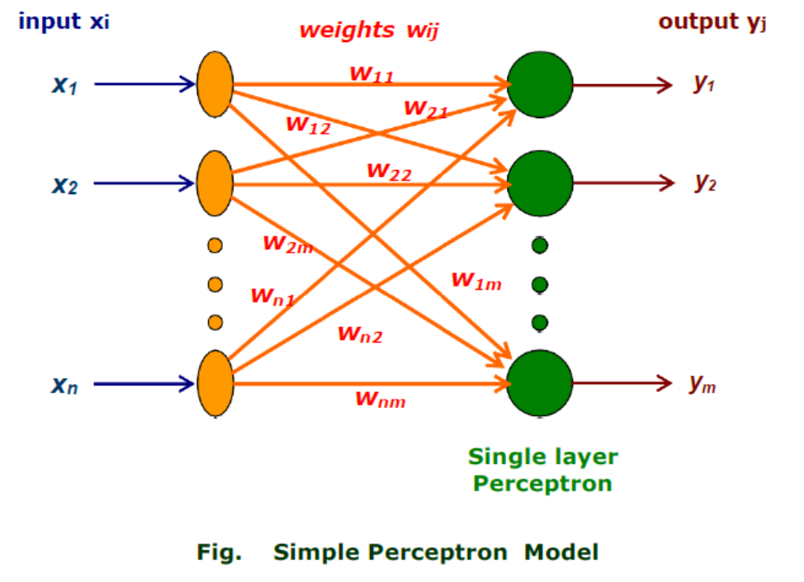

Slide 75
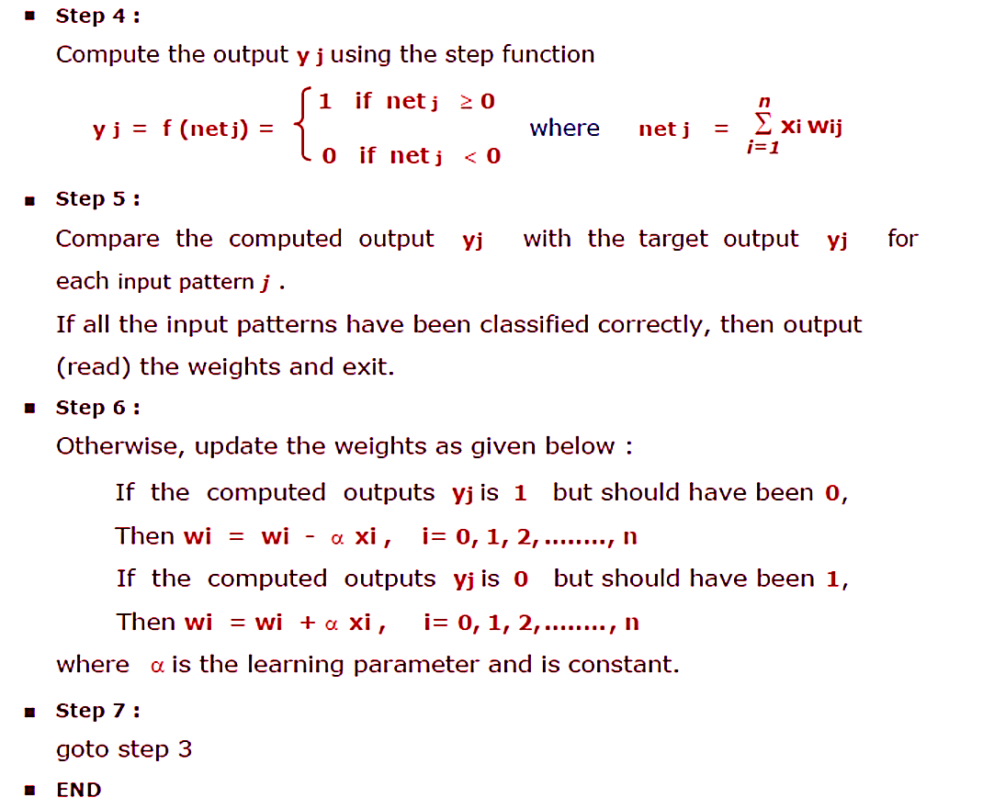

Slide 76


Slide 77



Slide 78
References:
Ethem Alpaydin, Introduction to Machine Learning , MIT Press, Prentice Hall of India, Third Edition 2014.
J. Han, J. Pei, & M. Kamber, (2011). Data mining: concepts and techniques. Elsevier.
J-S R Jang and C-T Sun, Neuro-Fuzzy and Soft Computing, Prentice Hall, 1997
S. Rajasekaran and G.A. Vijayalaksmi Pai ,Neural Network, Fuzzy Logic, and Genetic Algorithms - Synthesis and Applications, (2005), Prentice Hall.

